Slide 1


Fictional Book: A Captivating Tale
Embark on a journey into a world of imagination and intrigue, where a fictional book captivates readers with its compelling narrative and engaging characters.
Notes:
1

Slide 2
Executive Summary
The Story
Target Audience
The book presents a captivating tale with a unique plot, intriguing characters, and a well-developed world.
The target audience is avid readers seeking a captivating experience, with a focus on genre-specific demographics.
Notes:
2

Slide 3

Products and Services
Book
Audiobooks
The primary product is the fictional book itself, offering a complete and immersive reading experience.
Expanding reach with an audiobook version, allowing listeners to engage with the story in a new format.
E-books
Merchandise
Leveraging digital distribution through e-books, providing convenient access for readers on various devices.
Complementary merchandise like posters, bookmarks, and mugs, enhancing the brand and fan engagement.
Notes:
3

Slide 4
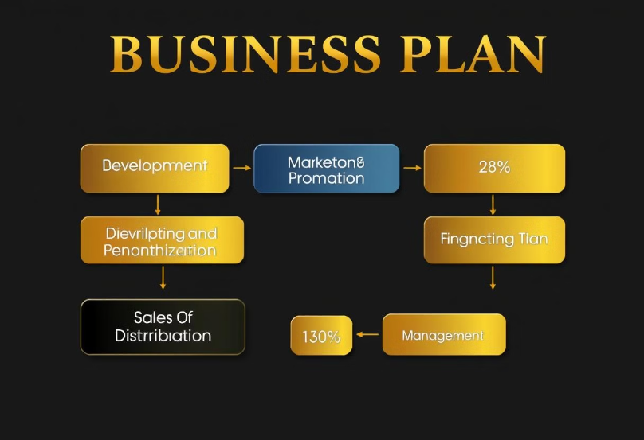
Business Plan
Development and Production
Marketing and Promotion
Sales and Distribution
Financial Management
The flowchart visually represents the key stages of the business plan, highlighting the percentage allocation of resources and effort to each area.
Notes:
4

Slide 5






Formatting Enhancements
Typography
Illustrations
Carefully selected fonts to enhance readability and aesthetic appeal.
Engaging illustrations to bring the story to life and enhance visual appeal.
Layout
Editing
A visually appealing layout to ensure smooth flow and reader engagement.
Thorough editing for grammar, spelling, and consistency to deliver a polished product.
Notes:
5

Slide 6



Target Audience and Market Analysis
Genre Enthusiasts
1
Avid readers of the chosen genre who are likely to enjoy the book's style and themes.
New Readers
2
Individuals seeking new and exciting reading experiences, drawn to the book's unique premise.
General Audience
3
Broad appeal through a captivating narrative and engaging characters, transcending genre boundaries.
Notes:
6

Slide 7
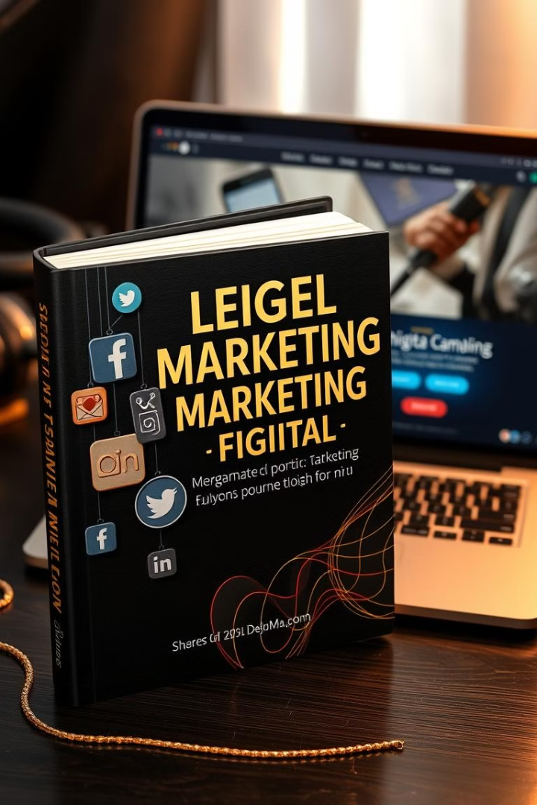



Marketing and Promotion Strategies
Social Media Marketing
Engaging content, targeted advertising, and community building to reach a wider audience.
Public Relations
Building relationships with media outlets, bloggers, and influencers to generate buzz and positive reviews.
Book Launches and Events
Organizing book signings, readings, and events to connect with readers and create a memorable experience.
Notes:
7

Slide 8
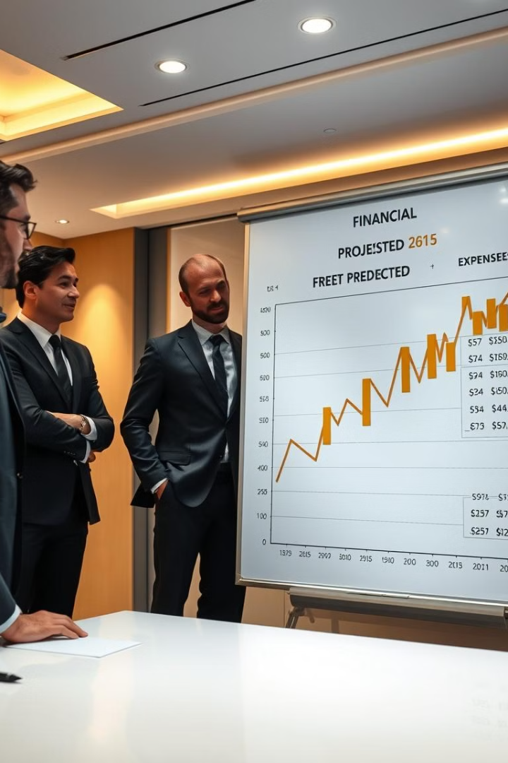
Financial Projections and Sustainability
10K
$20
Sales Target
Pricing
Aiming to sell 10,000 copies in the first year through various channels.
Setting a competitive price point of $20 per book, aligned with market trends.
3Y
Sustainability
Targeting a 3-year timeframe for achieving profitability and long-term sustainability.
Notes:
8

